Slide 1
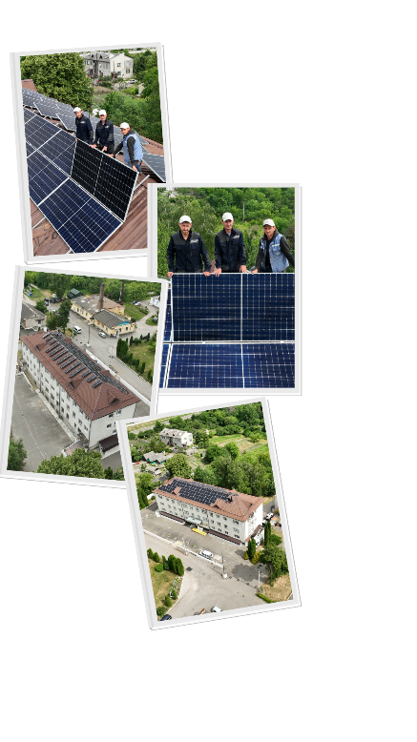


Solar Power Plants in Ukrainian Communities: Safety, Economy, and Durability
Dmytro Sakaliuk,
expert of the NGO Ecoclub

Slide 2
More about
NGO Ecoclub

Slide 3
Briefly about Ecoclub
More than 25 years of experience
16 employees
The annual budget is about 440 thousand euros
More than 100 projects implemented (information campaigns, SPPs in Voznesensk and Zviahel, changes to the process of extending the operation of nuclear units, etc.)
More than 10 thousand tons of humanitarian aid sent since the beginning of the war (about 150 thousand euros)
For more information, visit www.ecoclubrivne.org

Slide 4
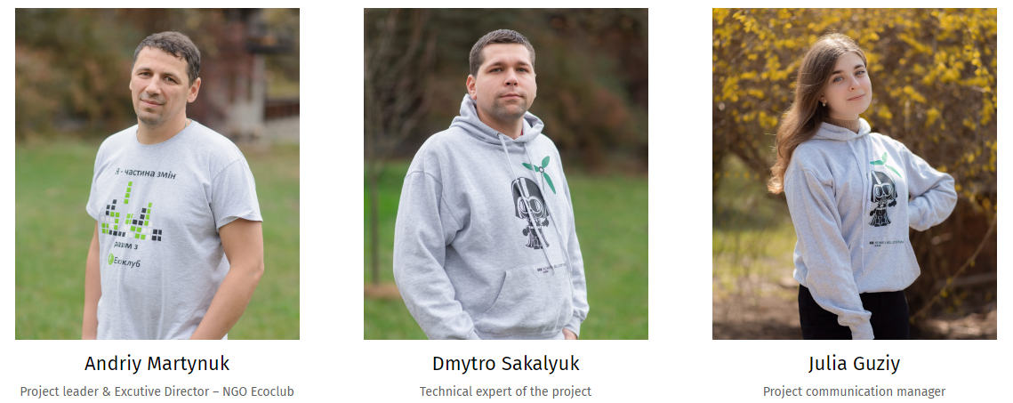
The team of SPP direction

Slide 5
Realized projects

Slide 6
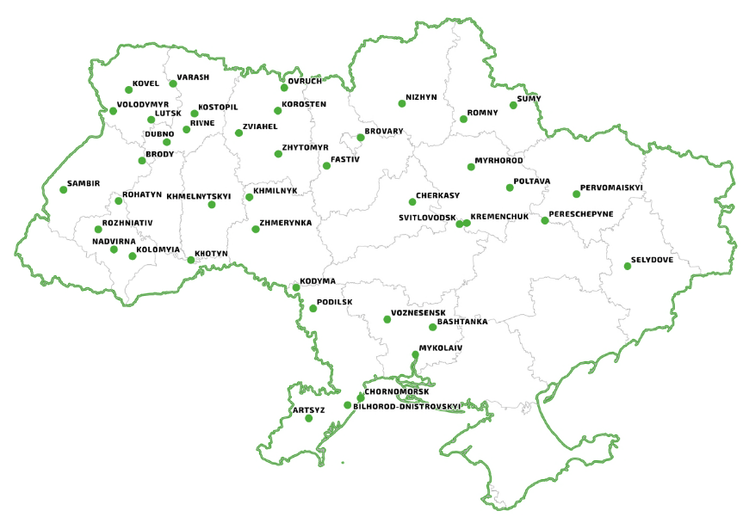
Partner communities

Slide 7
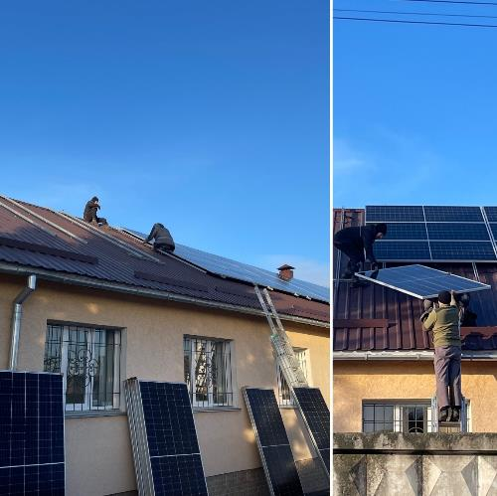
Zviahel, hospital - 32 kW
City hospital, Zviahel, Zhytomyr region
On-grid SPP is coordinated with the generator operation
Started working on 12/29/2022
Turnkey cost - 25 490 USD
Funds were received within the framework of the Sustainability4Ukraine webathon from CSR.Europe, CSR.Ukraine and Dobro.UA and NGO Ecoclub
170 000 people can be treated in a medical facility as needed
Electricity generated as of September 13, 2023 – 25 866 kWh

Slide 8
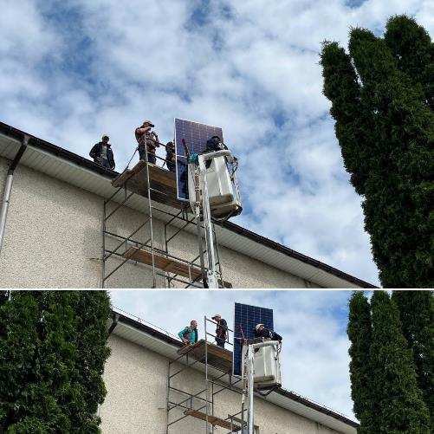
Dubno, hospital - 44 kW
City Hospital, Dubno, Rivne Oblast
On-grid solar power plant
Started working on 26.06.2023
Turnkey cost 42 080 USD
Funded by the German Embassy, the City Council and NGO Ecoclub
170 000 people can be treated in a medical facility as needed
Electricity generated as of September 13, 2023 – 15 351 kWh

Slide 9
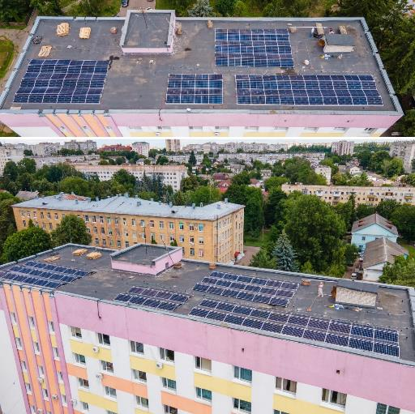
Zhytomyr, hospital - 48 kW
City Hospital, Zhytomyr
On-grid solar power plant
Started working on 04.07.2023
Turnkey cost 36 393 USD
Equipment from SolSol, the city council and Ecoclub
118 000 people can be treated in a medical facility as needed
Electricity generated as of 09.09.2023 - 12 138 kWh

Slide 10
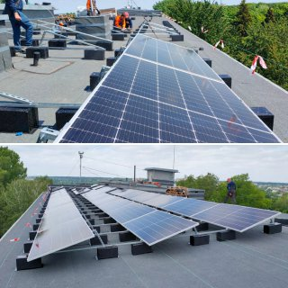
Sumy, hospital - 60 kW
City Hospital, Sumy
On-grid SPP is coordinated with the generator operation
Started working on 05.07.2023
Turnkey cost 50200 USD (documentation)
Funds from the NGO Ecoclub and a city council
227 500 people can be treated in a medical facility as needed
Electricity generated as of 09.09.2023 - 16 158 kWh

Slide 11
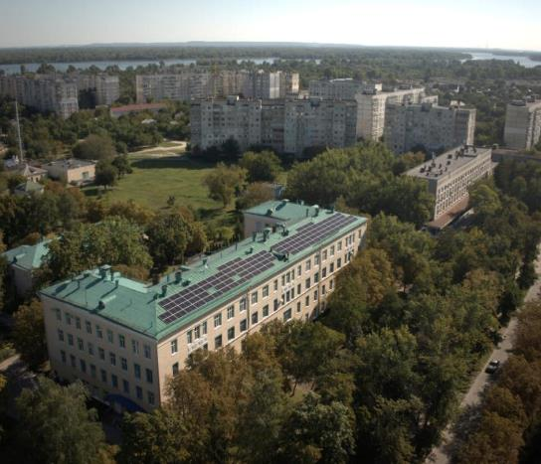
Kremenchuk, hospital - 60 kW
City Hospital, Kremenchuk
On-grid solar power plant
Started working on 05.09.2023
Turnkey cost 43 180 USD
Funds from NGO Ecoclub and a city council
44 800 people can be treated in a medical facility as needed
Electricity generated as of September 13, 2023 – 1 469 kWh

Slide 12
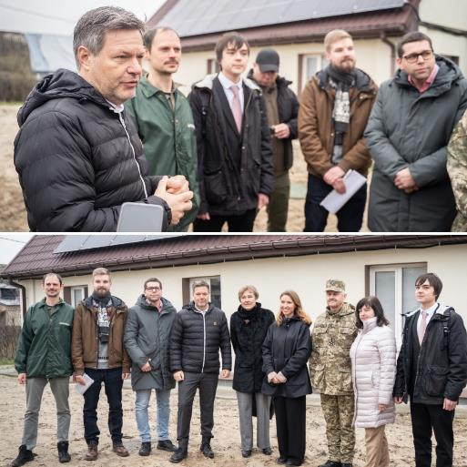
Gorenka, outpatient clinic
Zhytomyr
Outpatient clinic, Horenka village, Kyiv region.
Greenpeace Central and Eastern Europe, NGO Ecoaction and NGO Ecoclub
56000 EUR
12 kW SPP, 8 kW batteries, 20 kW heat pump
EUR 1 million for firm projects from the German Government
German Minister of Economic Affairs and Climate Protection Robert Habeck at the restored outpatient clinic in Horenka

Slide 13
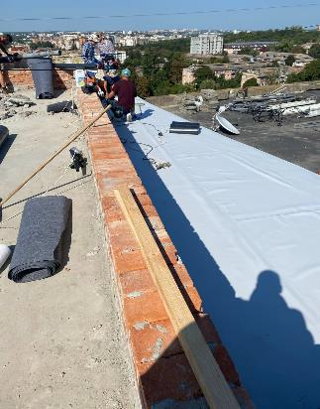
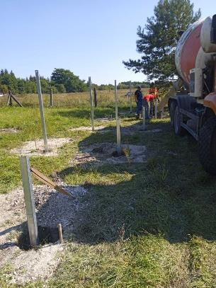
In the process of construction
Brody Water utility, Lviv region.
  Power 100 kW
  Own funds of a community
Water utility Zviahel
  Power 150 kW
  Own funds of a community
Regional dentistry in Rivne
  Power 34 kW
  Funds from the German Embassy, community funds, NGO Ecoclub

Slide 14
Preparation of documentation and completion of construction in 2023
Nizhyn, Chernihiv region, maternity hospital
Brovary, Kyiv region, children's hospital
Mykolaiv Children's Hospital
Zviahel, kindergarten
Sumy, object of nature reserve fund

Slide 15
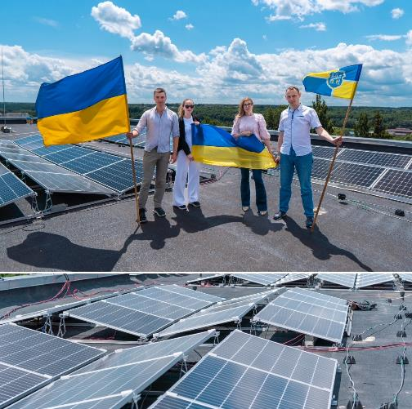
Plans for 2024
Kamianka, Chyhyryn, Bohuslav water utilities - support from Skatek for a total of EUR 110 thousand
Water utilities on a competitive basis for a total of 260 thousand euros - support from Oxfam
Solar power plant at a hospital in Zhytomyr.

Slide 16
Involvement in the process
Korosten - won funds from GIZ based on the results of the pre-feasibility study
Vinnytsia - development of project design and construction of SPPs at three hospitals

Slide 17
Forms and features of financing

Slide 18
Methods of financing
Donor Funds
Community's own funds
Equipment
Through the account of Ecoclub
Support of Ecoclub at all stages
Support of Ecoclub at all stages
Through the community account
Через рахунок донора

Slide 19
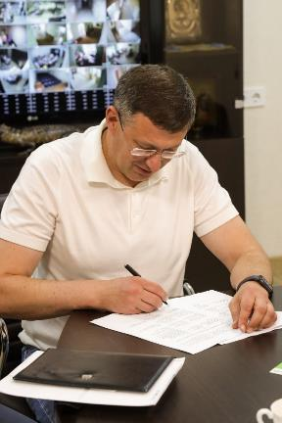
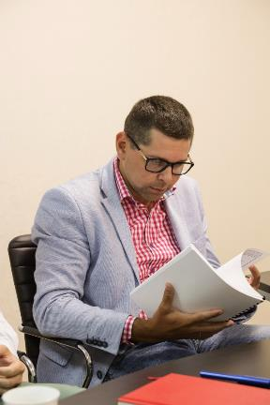
Where the money comes from
Small donations from people and businesses around the world
  The source seems to be expired
Oxfam
European Climate Foundation
Grant support from governments and the European Commission
Targeted donations from foreign companies
Community funds
The process of signing an agreement to start installing a solar power plant in Brovary, Kyiv region.

Slide 20
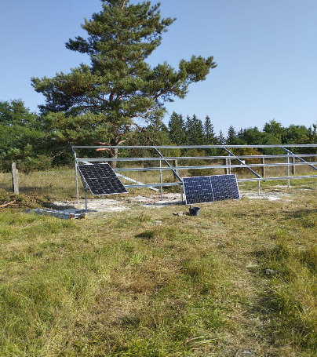
Why some communities manage to build SPPs, while others do not
High-quality source data
Co-financing
Readiness to work quickly (energy management at the proper level)
Providing 1000 and 1 clarifying answers to an additional request
Willingness to take responsibility
Solving any issue on the spot

Slide 21
How they are being installed: step by step

Slide 22
What the process looks like
  Selection of the community and the facility
  Preliminary feasibility study
  Object survey, or feasibility study
  Roof/land plot inspection report
  Design and estimate documentation
  Construction
  Information campaign

Slide 23
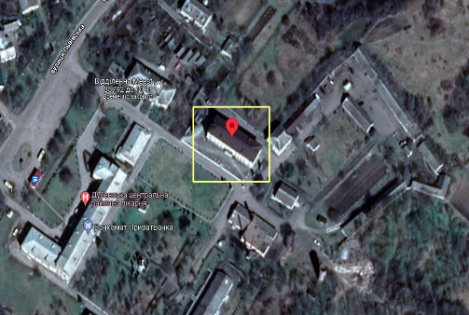
Selection of the community and the facility
The form is available on the Ecoclub's website - https://forms.office.com/e/G7xj7rd35
Political will
High-quality initial data about the object
Co-financing (optional)

Slide 24

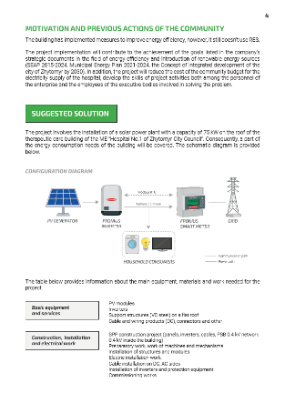
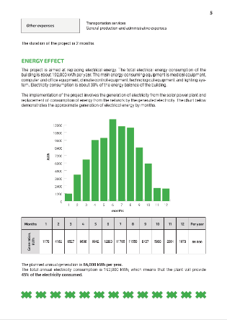
Preliminary feasibility study
First assessment of project feasibility
We speak to donors in the language of numbers and facts
We have already made 30 and plan to make 20 more by the end of the year

Slide 25
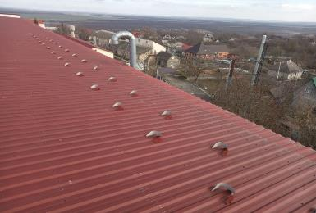
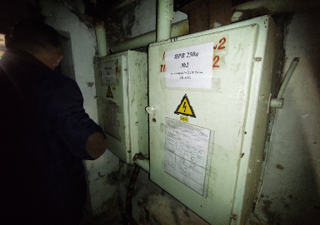
Survey of the object or feasibility study
Only when there are serious developments in financing
Detailing and final technical solutions for the design and construction project
Technical condition of the roof, electrical grid (substation, switchboard, grids)

Slide 26
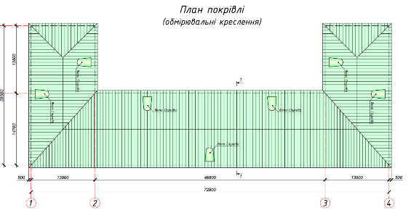
Roof/land plot inspection report
Only when there are serious developments in financing
The calculation for additional load is approximately 100 kg/sq.m.
Lack of networks on land plots
The cost of the roof certificate is about UAH 30 thousand (paid by the community).

Slide 27
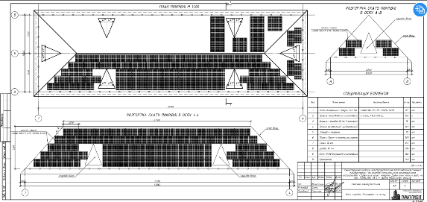
Design and estimate documentation
Only with guaranteed financing
Lack of quality contractors
Queues/start-up complexes when financed by donor funds and the local budget
Expertise
It takes about 6 weeks on average to make

Slide 28
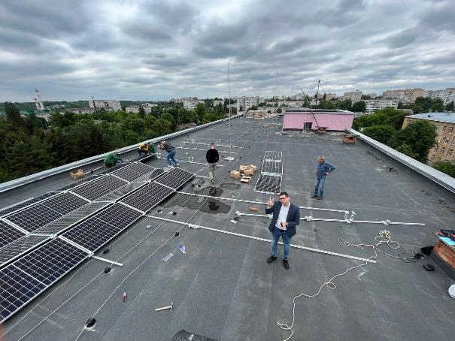
Construction
Ecoclub helps to prepare / prepares tender documents
Lack of quality technical supervision
A rooftop station of up to 100 kW is built in 10 days
The time of year has no critical impact on construction

Slide 29
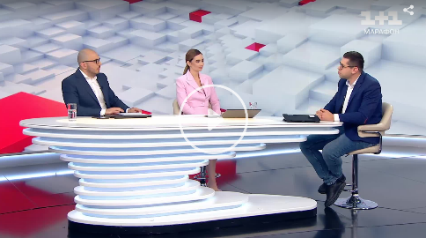
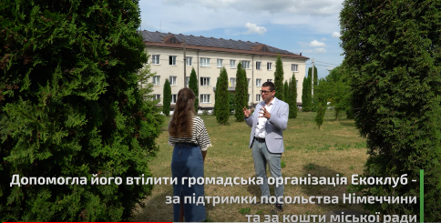
Information campaign
People are also afraid of the spread of information
Reporting to donors
Search for new opportunities
Promoting an idea for large-scale change

Slide 30
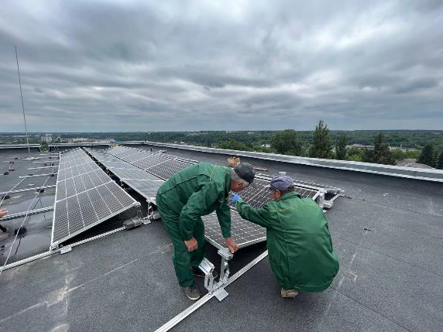
Technical and organizational issues
Approval of DSOs
Construction in sanitary zones
No hourly consumption schedules
Lack of a list of all electrical equipment

Slide 31
Difficult questions:
Simply about the complex

Slide 32
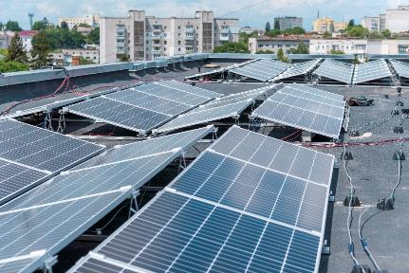
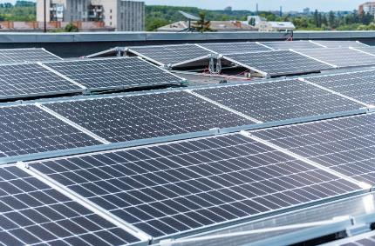
How SPP changes the operating conditions of a facility
SPP is an additional source of electricity for the end user, thus increasing the reliability of electricity supply
SPPs with batteries provide a certain autonomy (it is important to choose the right battery capacity and equipment power lines)
SPPs generate electricity several times cheaper than diesel generators
  However, they require high initial investments

Slide 33
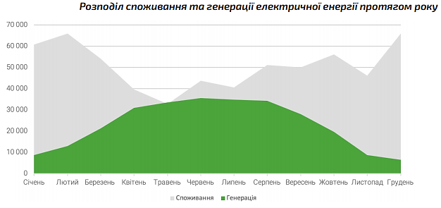
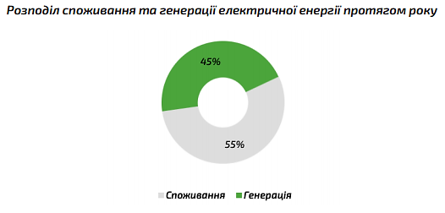
Important limitations
Financial constraints
Roof/land area
Graphs of energy consumption in the hospital
The goal to be achieved
Other (space, ventilation, staff, strategic vision, etc.)

Slide 34
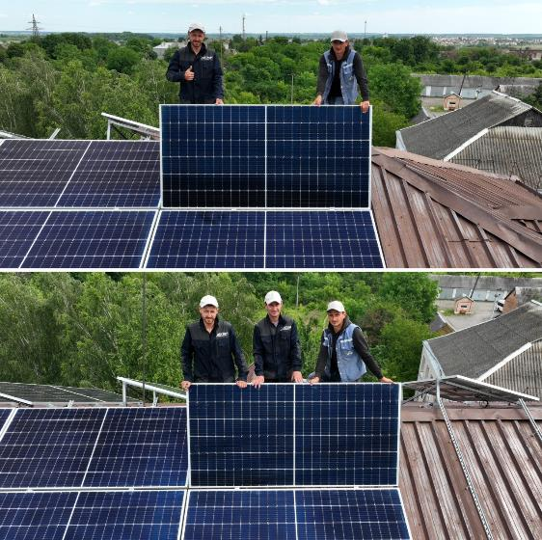
Contractors and equipment
Lack of service providers for the development of documentation: pre-feasibility study; feasibility study; design and construction documents; acts of technical inspection of buildings

Slide 35
Recommendations
Create incentives for municipalities
  Documentation templates
  Assistance from energy supply companies
  Technical consultations
Create affordable loans in local currency or with risk insurance
Raise awareness and professionalism of municipal representatives
Provide professional technical supervision
Development of the design sector

Slide 36
Thank you!
Dmytro Sakalyuk
+38 067 363 41 10
sakaliyk@ecoclubrivne.org
ecoclubrivne.org

